Slide 1
Scoring the OBPA
Sarah M. Psillas, PhD, OTR/L, CEIS
Wendy B. Stav, PhD, OTR/L, FAOTA

Slide 2
Assessing Practice with the OBPA
Occupational Profile:
Client works in an office, spending a lot of time on a computer
Enjoys gardening and line dancing
Dx: distal radius fracture
Goal: Increase forearm pronation
Three Intervention Scenarios
Medical model
Intermediate
Occupation-based

Slide 3
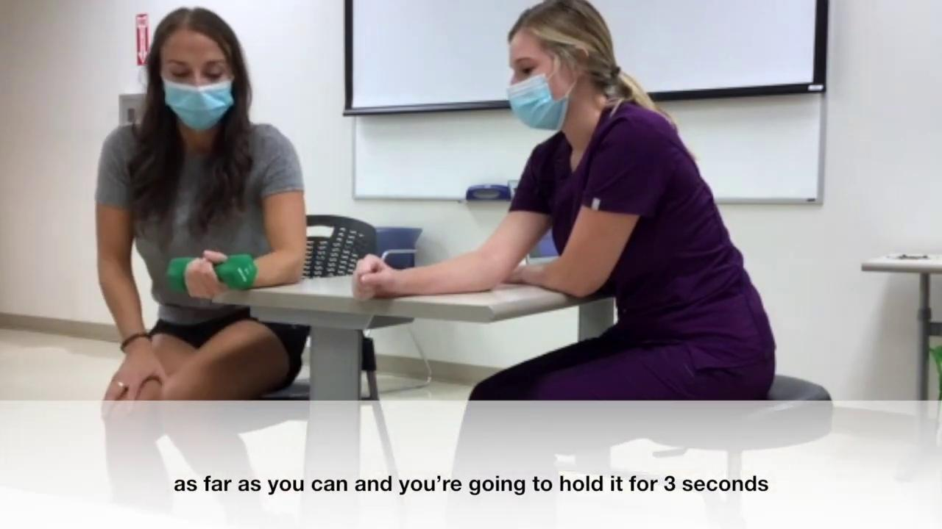
Medical Model Practice

Slide 4
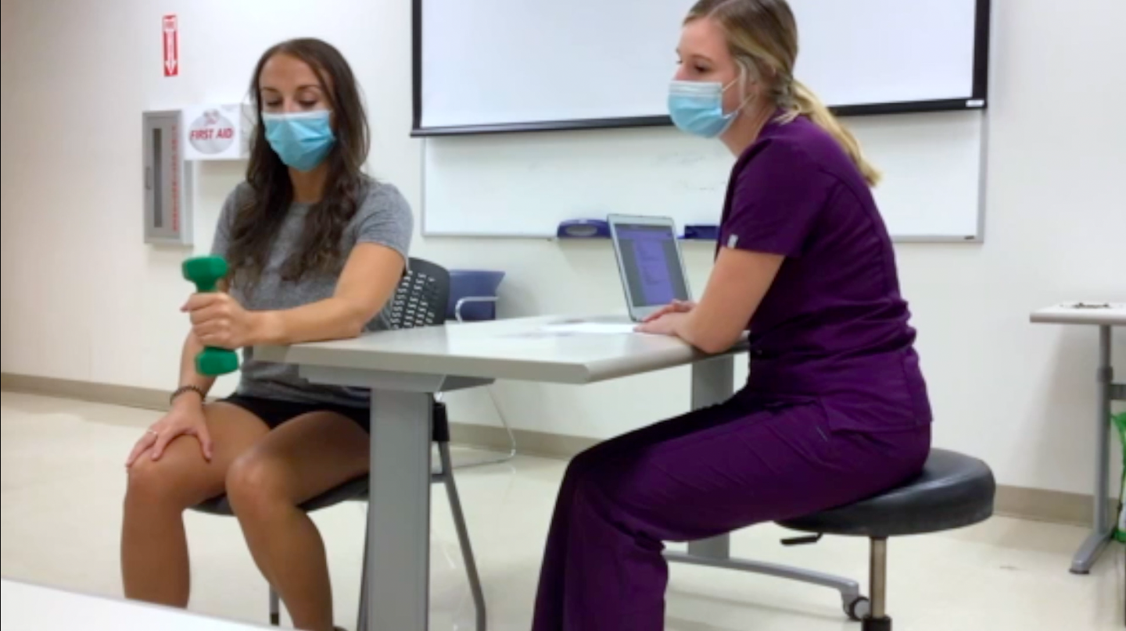
Materials Used
“Simulated objects” selected because a hand weight is not used in an occupation.

Slide 5
Context
“Not related” selected because the therapy gym is not related to the occupations performed in the client’s work or home environment.

Slide 6
Actual Doing
“Preparatory or rote movement” selected because the client is repeatedly rotating the forearm.
Click video to play

Slide 7
Meaning
“Therapist chose activity” selected because the therapist generated the exercise idea.
Click video to play

Slide 8
Associated with client stated goals or occupational profile
“Not associated with goal” selected because weight exercises are not related to her desire to return to work.
Click video to play

Slide 9
Deliberate Therapeutic Interaction
“Directly addresses skill or occupation in need” selected because the exercise targeted the limited forearm pronation required for typing.
Click video to play

Slide 10
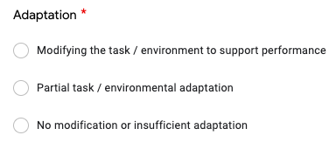
Adaptation
“No modification or insufficient adaptation” selected because the intervention remained static and was not modified.
Click video to play

Slide 11
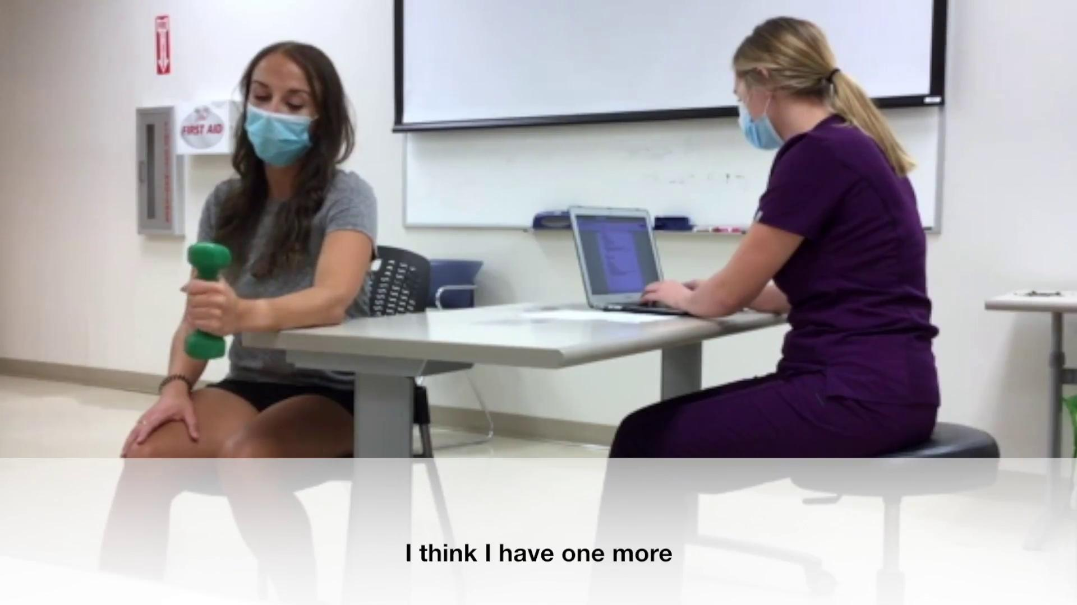
Participation
“Coaxed or intermittent performance” selected because the client was distracted and not fully attending to the exercise, needing prompting from the therapist.
Click video to play

Slide 12
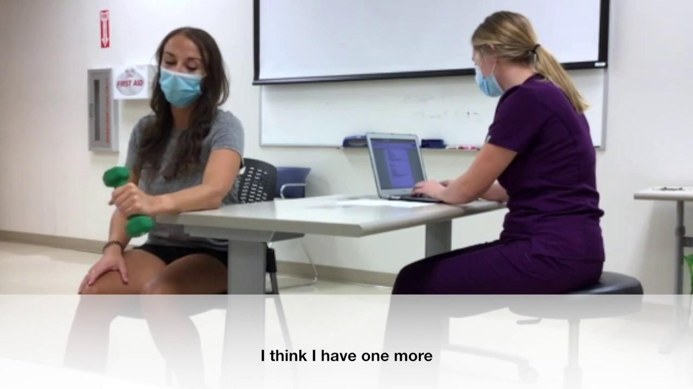
Therapist Collaboration
“Supervision from therapist” selected because there was no active interaction with the therapist.
Click video to play

Slide 13
Intermediate Practice

Slide 14
Materials Used
“Simulated objects” selected because beads provide simulated engagement to an occupation.

Slide 15
Context
“Not related” selected because the therapy gym is not related to the occupations performed in the client’s work or home environment.

Slide 16
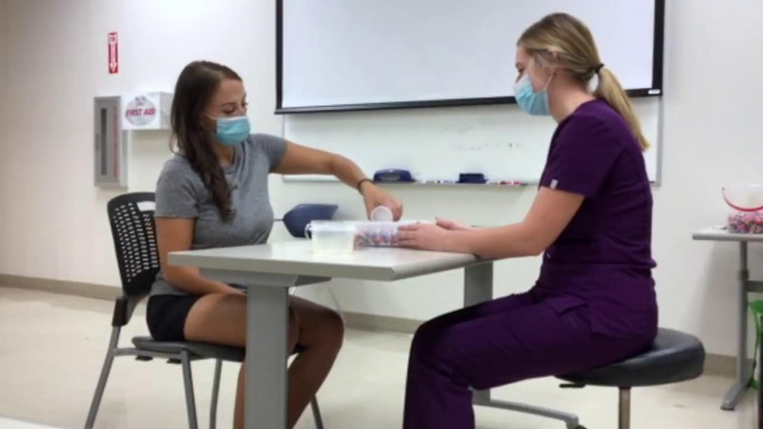
Actual Doing
“Contrived / simulated activity” selected because scooping and dumping beads simulates the pronation movement used in typing.
Click video to play

Slide 17
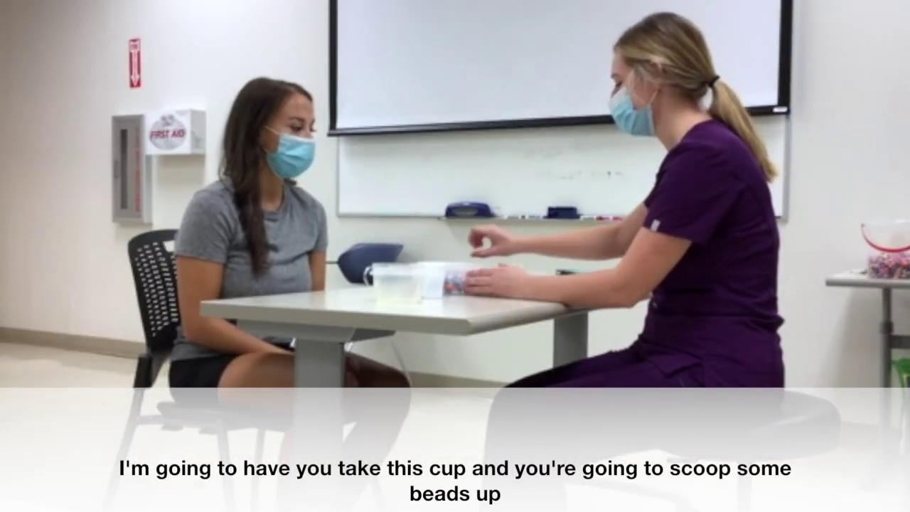
Meaning
“Therapist chose activity” selected because the therapist generated the simulated idea and the client remained compliant during the activity.
Click video to play

Slide 18
Associated with client stated goals or occupational profile
“Not associated with goal” selected because scooping beads is not related to her desire to return to work.
A desktop activity using a mouse, keyboard, or manipulating papers would be aligned with the client’s goal.
Click video to play

Slide 19
Deliberate Therapeutic Interaction
“Directly addresses skill or occupation in need” selected because the exercise targeted the limited forearm pronation for the client to return to work at a computer.
Click video to play

Slide 20
Adaptation
“Modifying the task” selected because the therapist gave verbal cues to reduce shoulder compensation when scooping and positioned the box of beads to allow client access.
Click video to play

Slide 21
Participation
“Actively engaged” selected because the client actively listens, acknowledges, and incorporates feedback.
Click video to play

Slide 22
Therapist Collaboration
“Therapist directed / guided activity” selected because instructions were provided but no interpersonal connection facilitated the interaction.
Click video to play

Slide 23
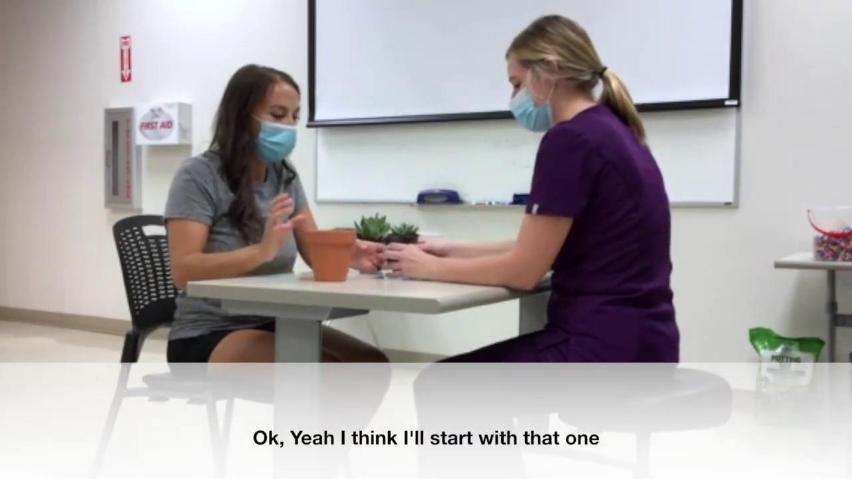
Occupation - Based Practice

Slide 24
Materials Used
“Actual occupation objects” selected because gardening tools and real plants were utilized.
Click video to play

Slide 25
Context
“Not related” selected because the therapy gym is not a natural environment for repotting a plant.
Click video to play

Slide 26
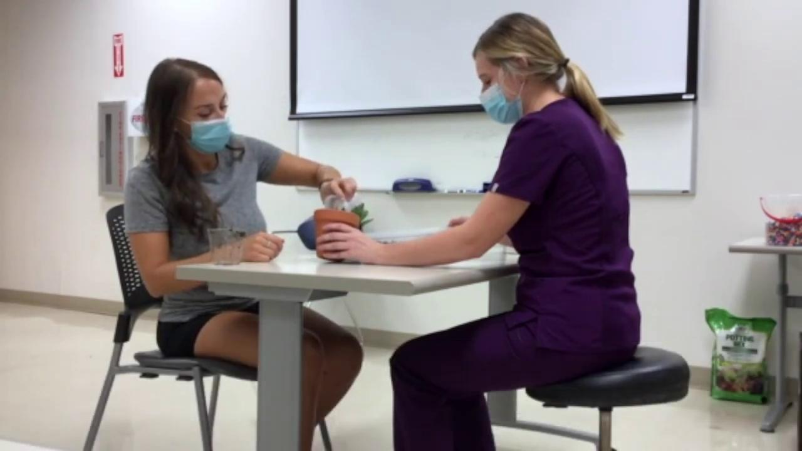
Actual Doing
“Execution of task or partial task” selected because the client completed the plant repotting activity.
Click video to play

Slide 27
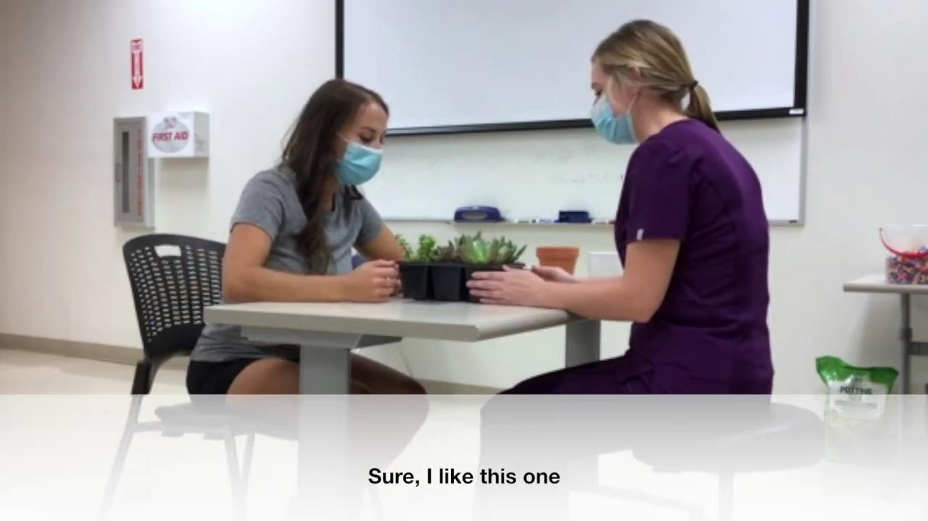
Meaning
“Client identified/selected activity” selected because the client had previously expressed interest in gardening.
Click video to play

Slide 28
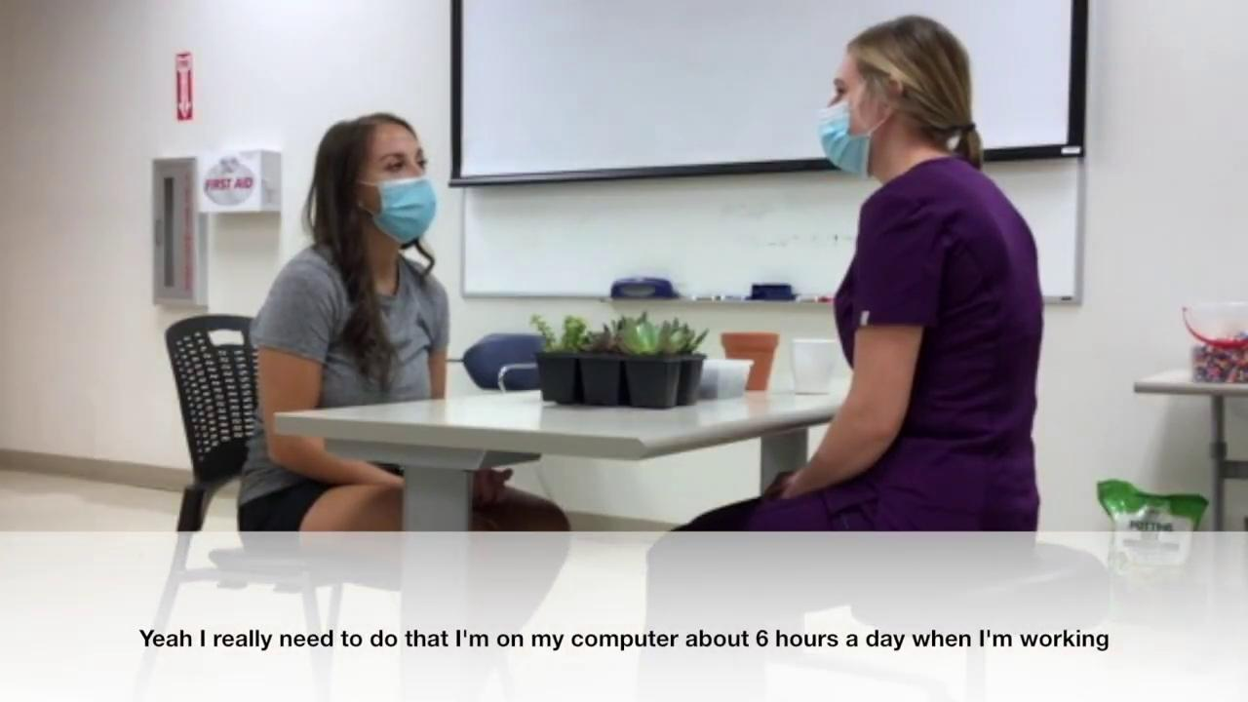
Associated with client stated goals or occupational profile
“Not associated with goal” selected because gardening is not related to her desire to return to work.
Click video to play

Slide 29
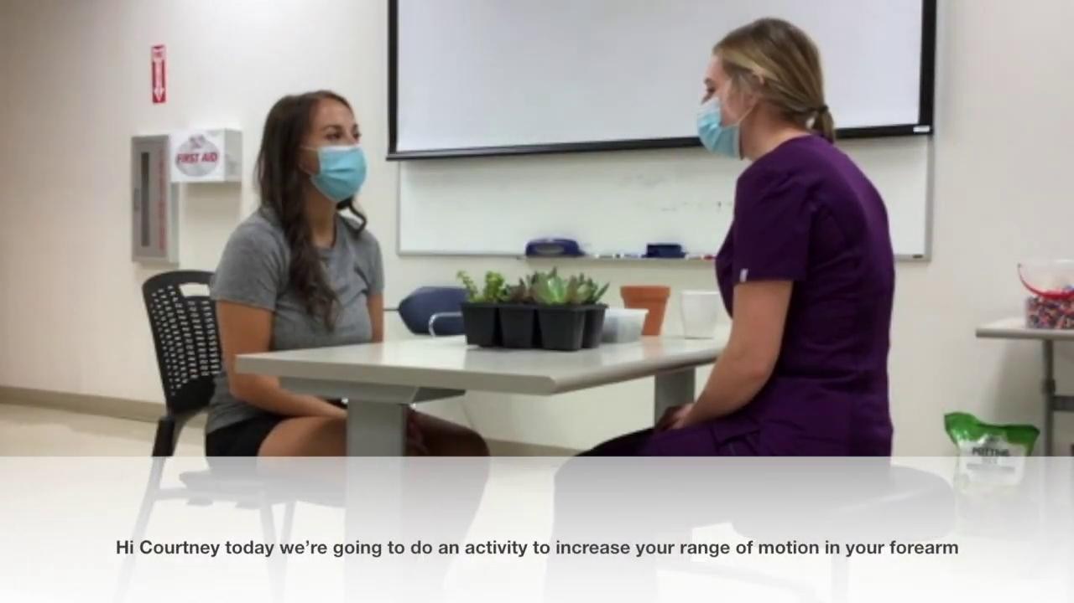
Deliberate Therapeutic Interaction
“Directly addresses skill or occupation in need” selected because repotting the plant targeted the limited forearm pronation.
Click video to play

Slide 30
Adaptation
“Modifying the task / environment to support performance” selected because the plant was removed for the client, the dirt was set up in an accessible shallow box, and the pot was stabilized.
Conversely, modification of a single aspect of the interaction would be a partial task adaptation.
Click video to play

Slide 31
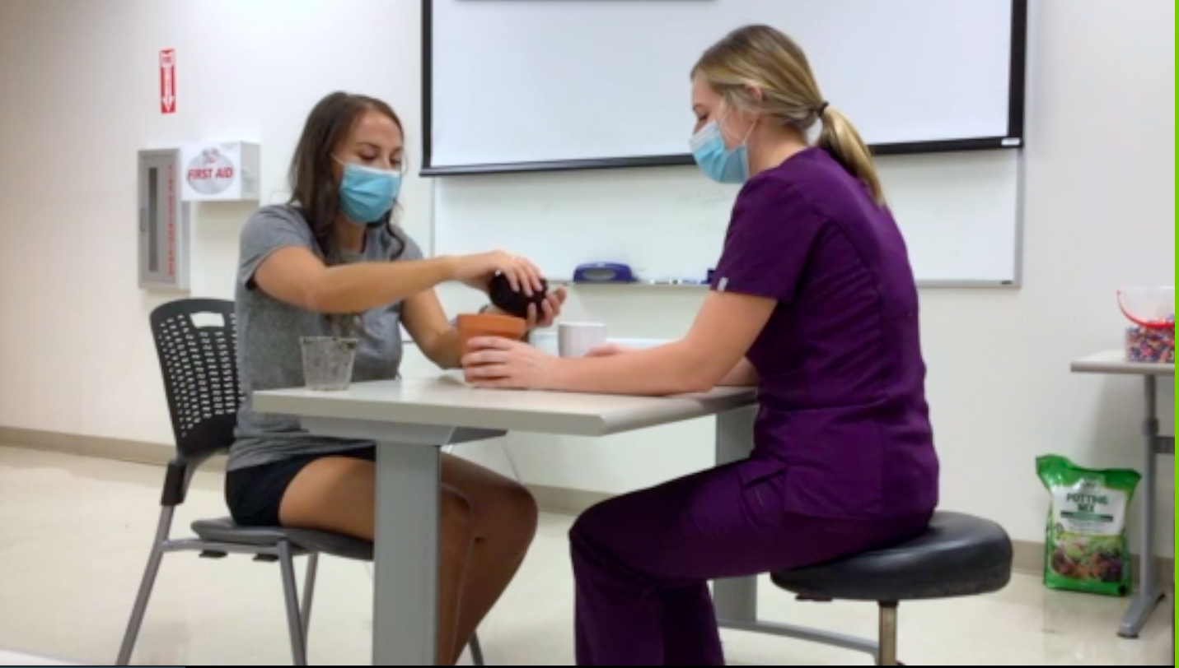
Participation
“Actively engaged” selected because the client actively and eagerly attended to the task without interruption or need for redirection.

Slide 32
Therapist Collaboration
“Therapeutic-use-of-self facilitating engagement” selected because therapist used her interpersonal connection with the client to facilitate a client-centered activity.
Click video to play

